Slide 1
Sean Koppenhafer, Jaime Rodriguez,
Chad Thueson, Noah Erickson, Rishal Dass
Project Proposal
Digital Dash
Portland State University
Department of Electrical and Computer Engineering (ECE)
Notes:
1
1

Slide 2
Overview
Project Overview & Requirements
Devices Chosen
Microcontroller
CAN Transceiver
LCD Screen
GUI Layout
Enclosure
Budget
Project Timeline
Notes:
2
2

Slide 3
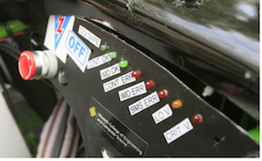

Project Overview
Electric systems add complexity and a traditional LED dash won't suffice
Drivers must be aware of system faults and warnings
An LCD Dashboard must be created to accommodate additional electrical systems
Formula SAE Electric Car
Current Traditional LED Dash

Slide 4
Project Requirements
Budget: $500
Timeline: March 2015
The display gather information from the CAN-bus and display it in a simple LCD GUI
Deliverables
One functional Unit
Well Documented Code
Professional Documentation
User Manual

Slide 5
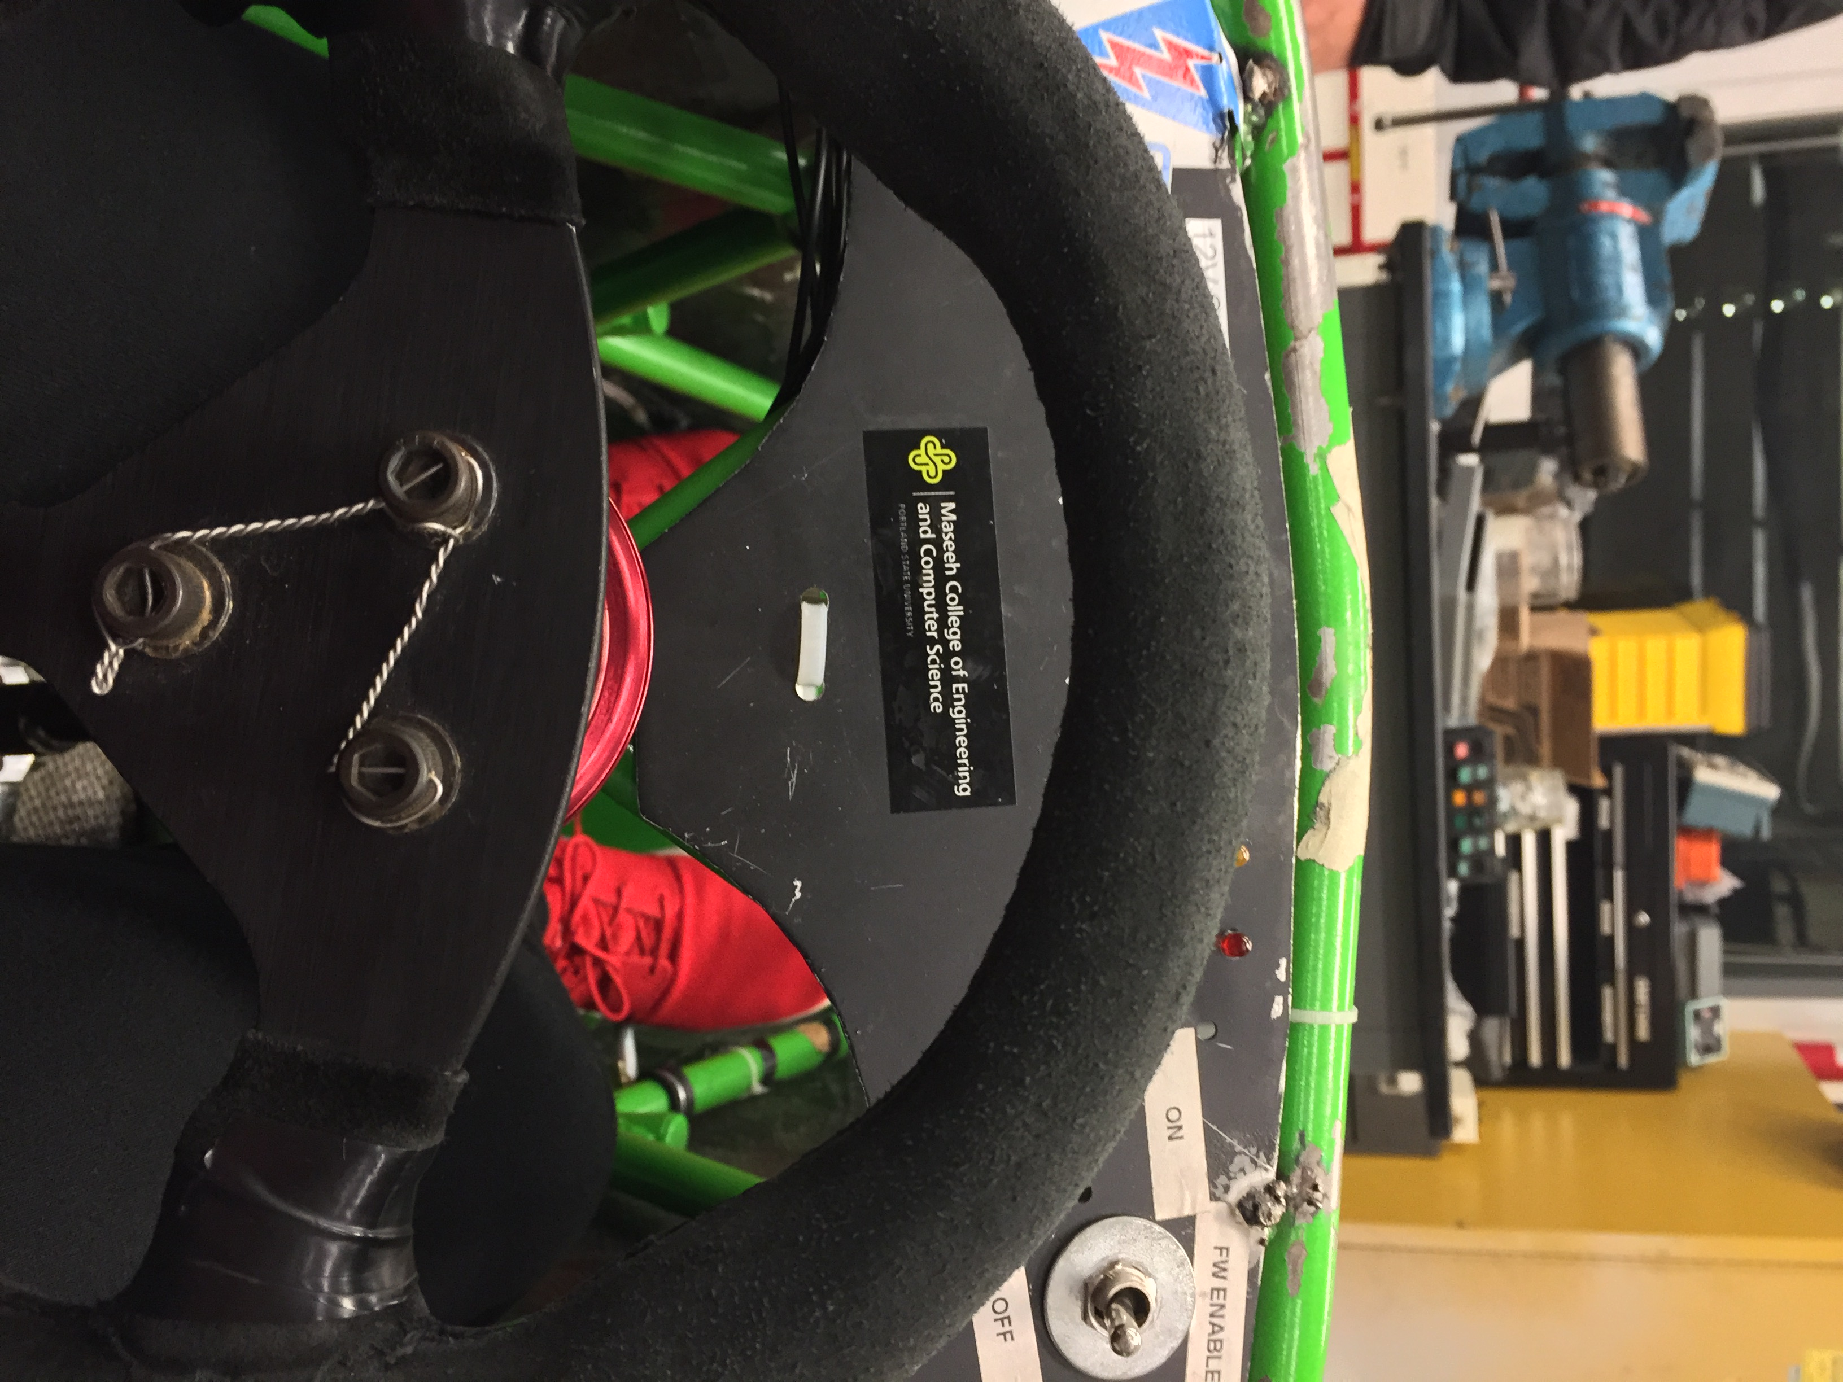
Design Constraints
Choose most suitable LCD display
Design the communication interface with VCU
Develop GUI
Design waterproof casing for the display
Physical space on dash is limited

Slide 6
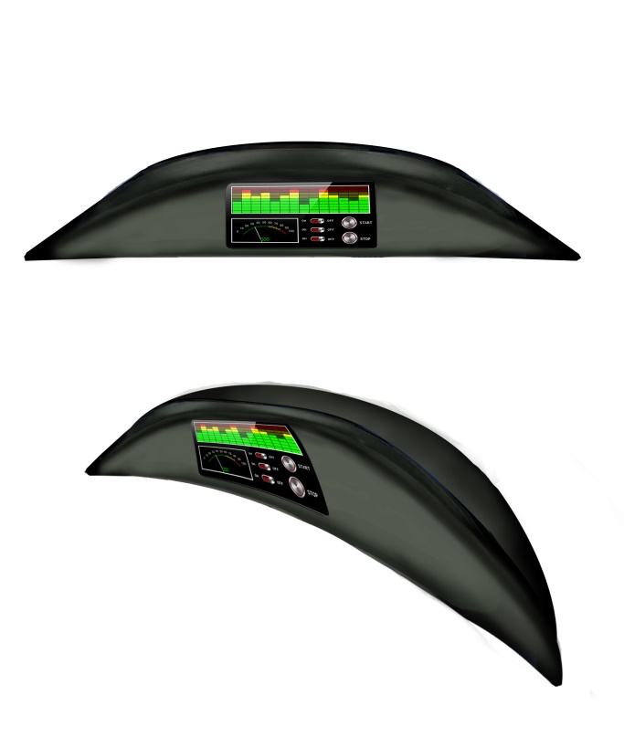
Devices Chosen
CAN Protocol for data acquisition with serial to LCD
AT90CAN Atmel
AMS-42700 On Semiconductor
uLCD-35DT 4D systems
Notes:
6

Slide 7

Microcontrollers
 | Cost | Fab Board | CAN Controller | CAN Library | SPI, I2C, UART, etc
Atmega 328 | ~$3 | Yes | No | No | Yes
AT90CAN | ~$8 | Yes | Yes | Yes | Yes
Arduino Uno | ~$25 | No | No | No | Yes
Arduino Due | ~$50 | No | Yes | No | Yes
Notes:
7

Slide 8
CAN Transceiver
 | Cost | Max Transfer Rate | Multiple CAN networks
AMIS-42700 | ~$6 | 1 Mbit/sec | Yes (2 networks)
MCP-2551 | ~$1.50 | 1 Mbit/sec | No (1 network)
Notes:
8

Slide 9
Reasons for Choices
CAN is the standard for vehicle communication
Low message transfer latency
Simplicity to implement and expand
Other options
Serial
Wireless
USB
Notes:
9

Slide 10

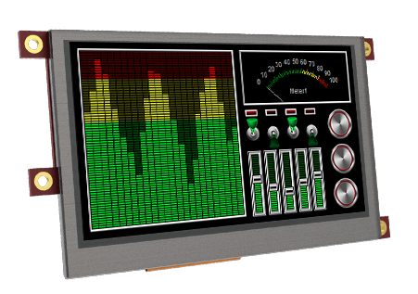
LCD Screen
2.7” LCD display 3.5” LCD display
4.7” LCD display (too large)
Pros
Resistive Touch
Color display
Power Graphics processor
Simple tools to create Gui
High Resolution
Cons
Screen is not polarized, difficult to see in sunlight (shield can be bought)
P/N uLCD-35DT
Notes:
10

Slide 11
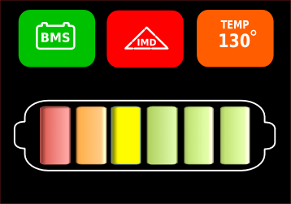
GUI Layout
Flashing warnings symbols will indicate errors in BMS, and IMD System.
Temperature indicator for motor or controller.
Battery meter will indicate voltages between safe and critical levels.
Proposed - Display GUI Layout (basic)

Slide 12
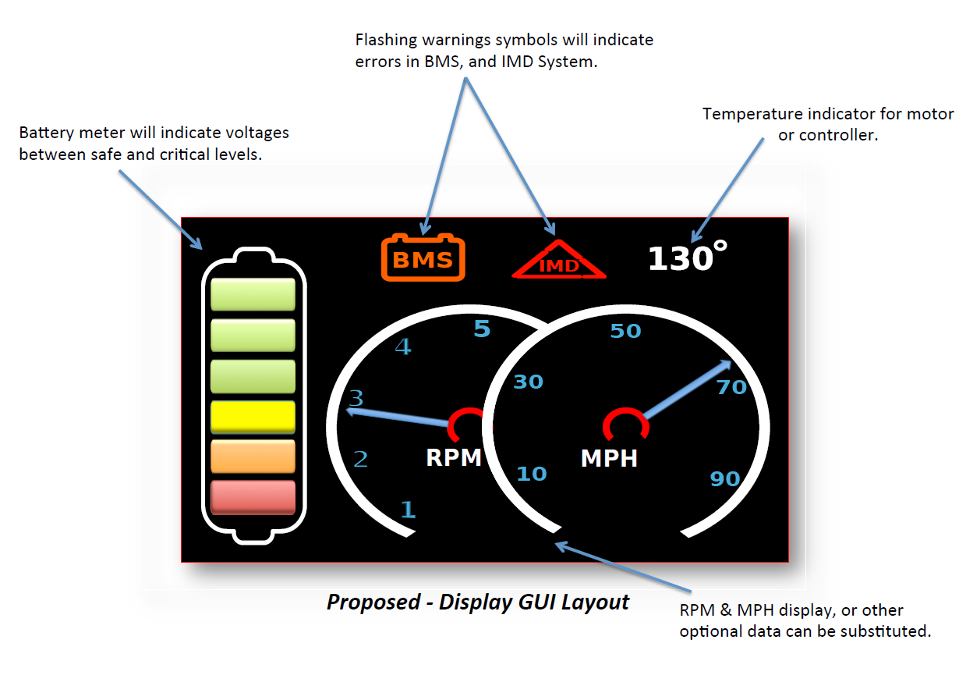
GUI Layout
Notes:
12

Slide 13
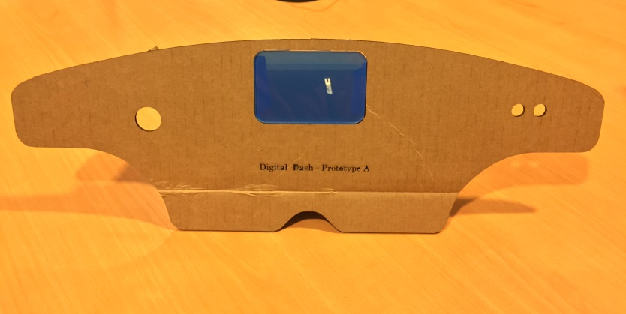
Enclosure
On top of dash
Pros
Looks good
Cons
3D Printed (expensive)
Sticks out of cockpit (rule violation?)
In Dash
Pros
Looks good
Waterproof
Cons
3D Printed (expensive)
Limited View
Notes:
13
13

Slide 14
Budget
AT90CAN ~$10, plus ~$20 for board FAB
4D 3.5" Screen ~$150 for screen & shield
Deutsch Connectors ~$10
Enclosure ~$50
$250 for one system
Notes:
14

Slide 15
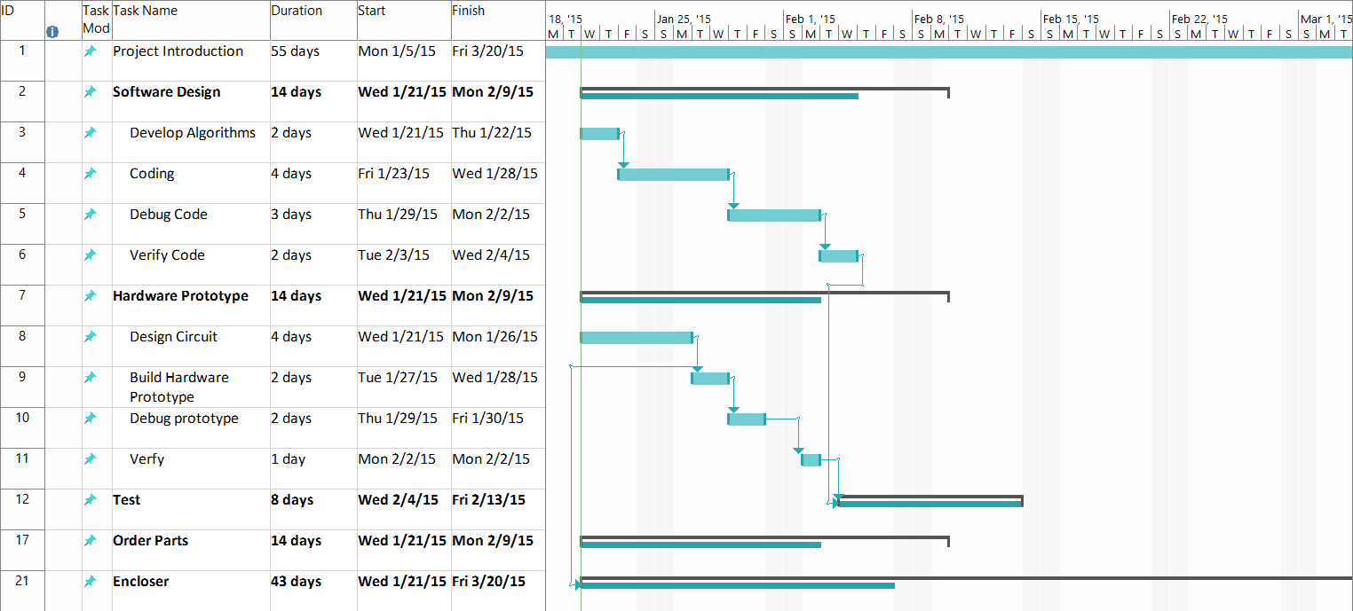
Project Timeline
Notes:
15

Slide 16
Questions & Concerns?
Notes:
16

